Slide 1

AMAZON WEB-SCRAPING
Izhan Abdullah

Slide 2
Web Scraping
Web Scraping is an automated method used to extract large amounts of data from websites quickly. It involves fetching the web content and extracting the desired information in a structured format.

Slide 3
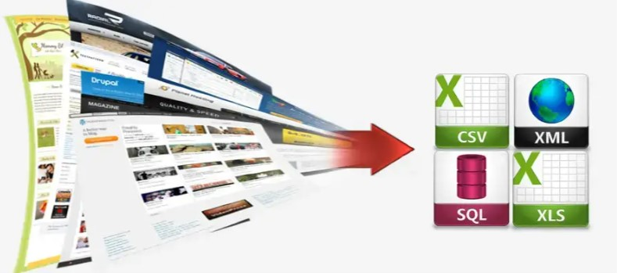
Converting Unstructured data to Structured data

Slide 4
Introduction
This project aims to collect product data from Amazon through web scraping techniques. It fetches information such as product name, price, reviews, and other relevant details.

Slide 5
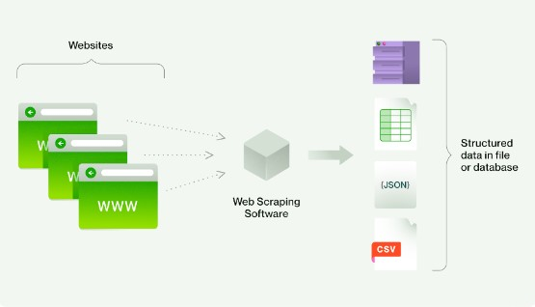

Slide 6
Features
Scrapes product details like name, price, reviews, etc., from Amazon.
Provides options for filtering and organizing scraped data efficiently.
Supports customization to scrape specific categories or products.
Saves scraped data in various formats for further analysis.

Slide 7




Technologies Used
Python
Beautiful Soup
Pandas
Numpy
Requests

Slide 8
Conclusion
In this project, we successfully developed an Amazon web scraping solution that automates the collection of vital product data. By efficiently extracting product details such as names, prices, and reviews, we enables users to derive valuable insights for market analysis and strategic decision-making in the e-commerce domain.

